Slide 1


ONLYF1S
2023 - 2024 Database Project
Mustafa Can Çalışkan 150200097
Emircan Erol 150200324
Yusuf Şahin 150200016
Yusuf Emir Sezgin 150200066
This Photo by Unknown Author is licensed under CC BY-NC-ND

Slide 2
Objective of OnlyF1s
An fandom website for Formula 1.
Everything you asked for an F1 site.
Users can dive into deep history of F1.
And much more…

Slide 3
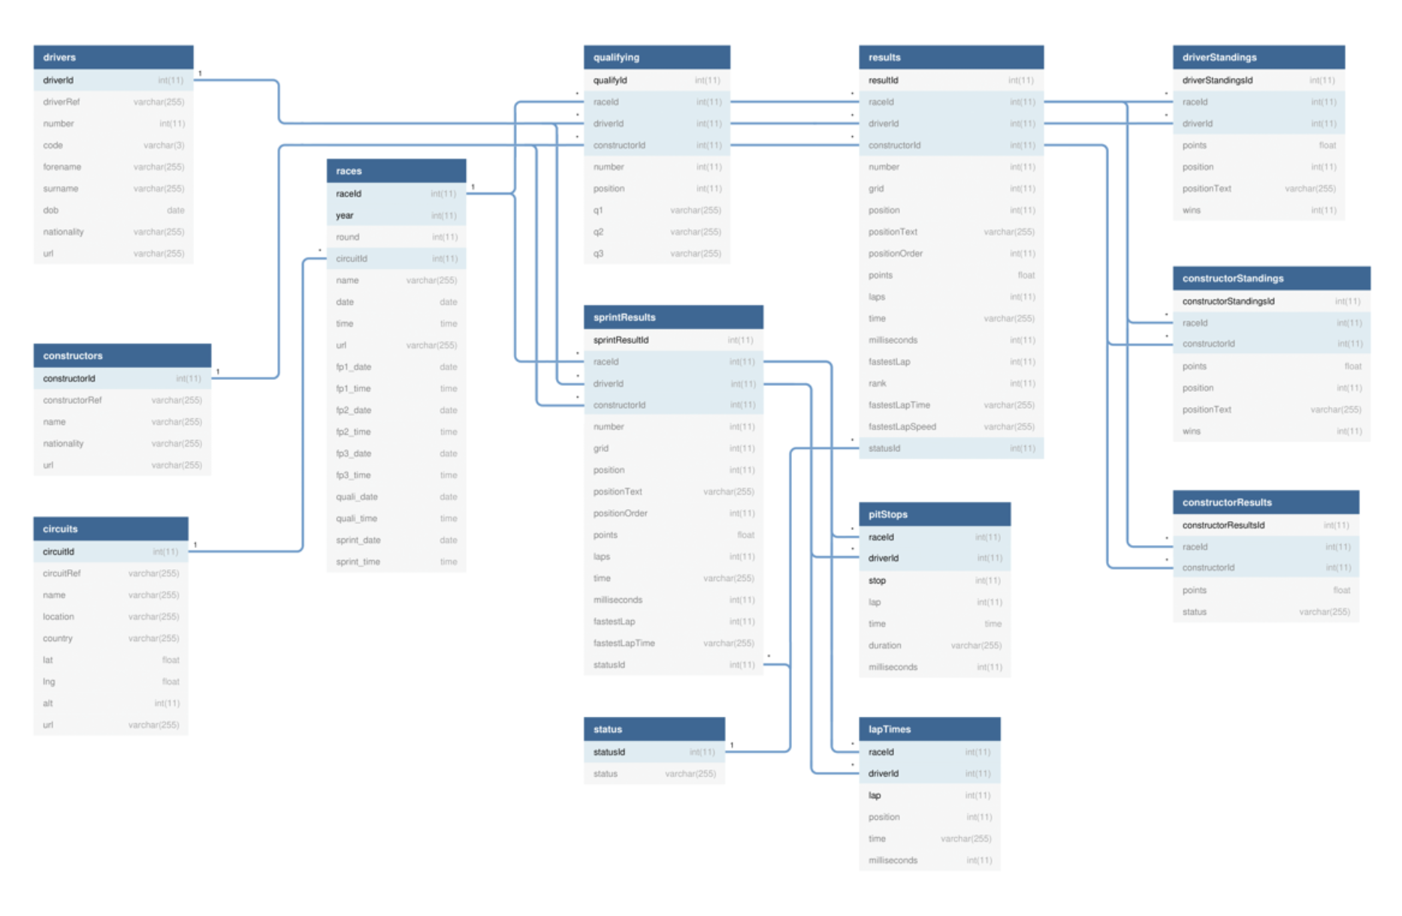
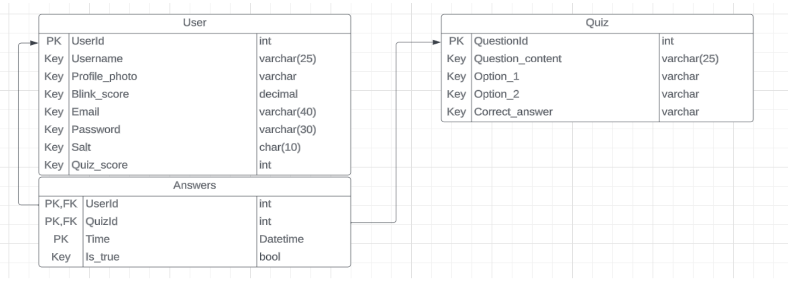
OnlyF1s DataBase

Slide 4
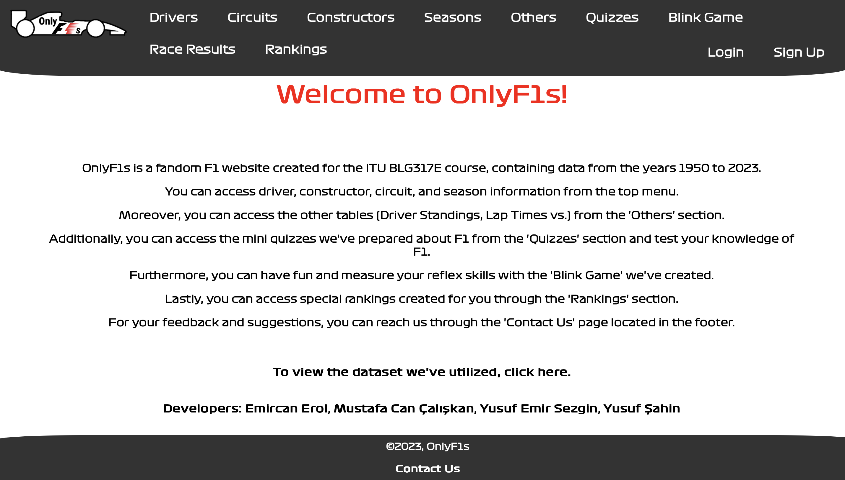
We can see the overall aspects of our site
Home Page

Slide 5
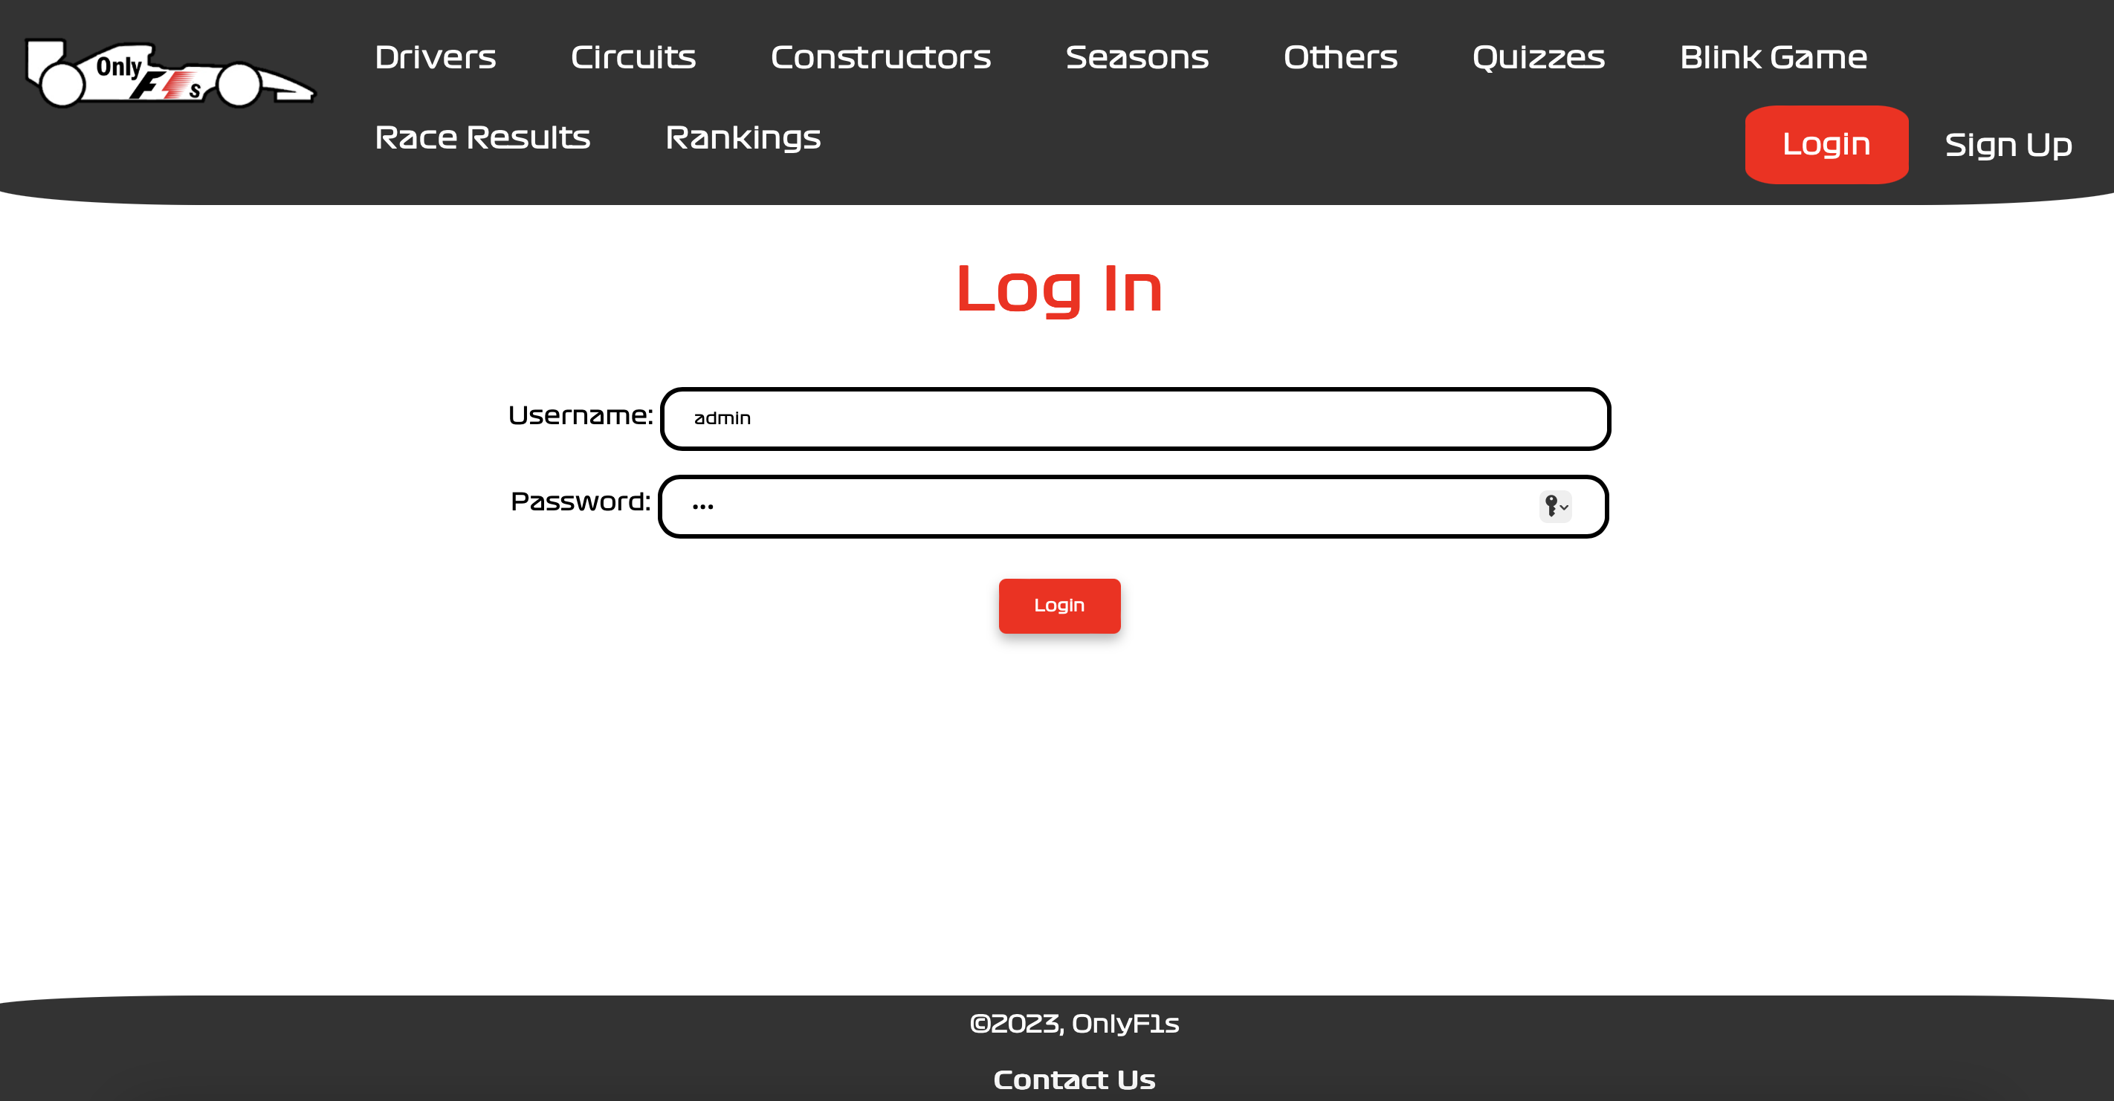
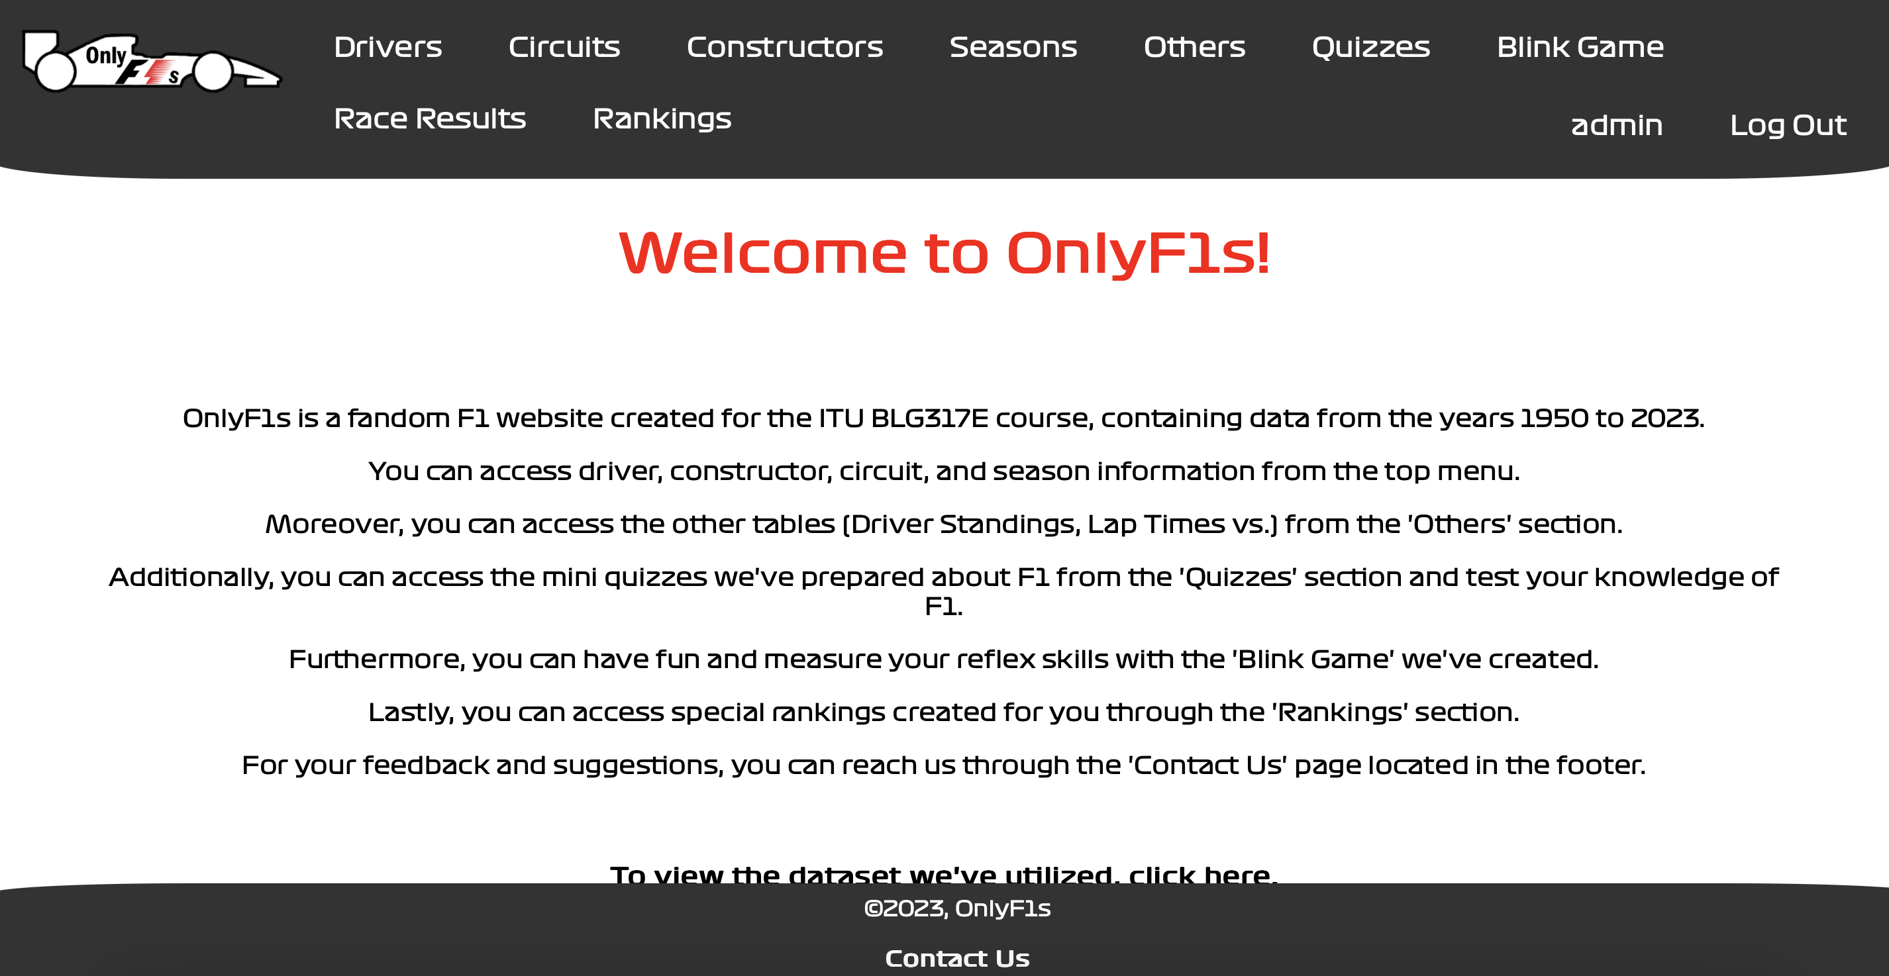
Login Page
We have two different user type for our site.
Admin and Generic User

Slide 6
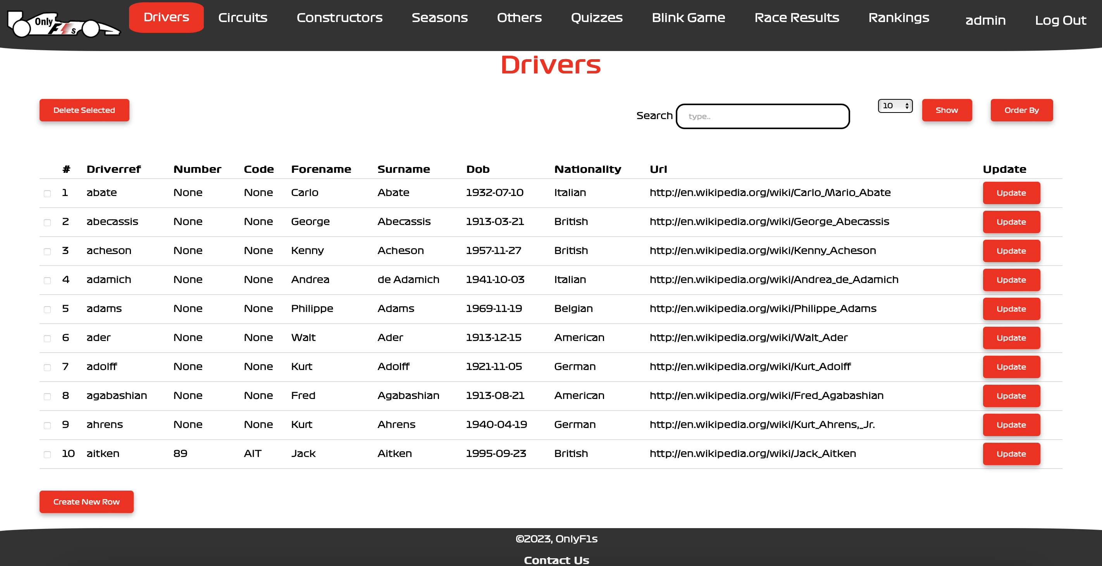
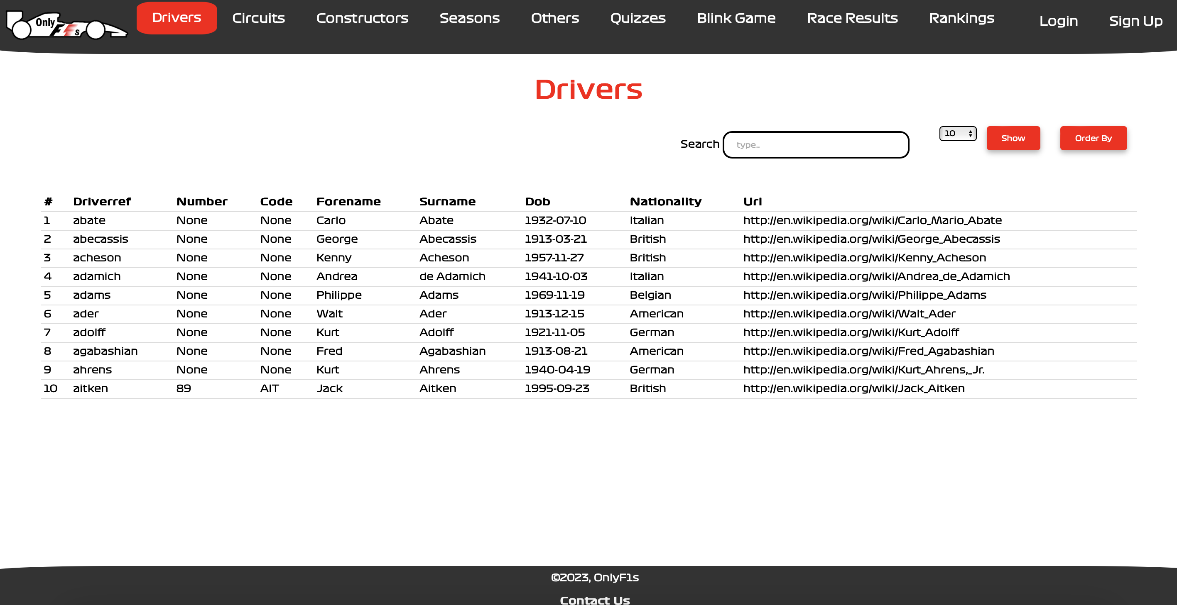
Admin can perform CRUD operations on a data as shown.
Admin Vs Generic User
Drivers Page for Admin User
Drivers Page for Generic User

Slide 7
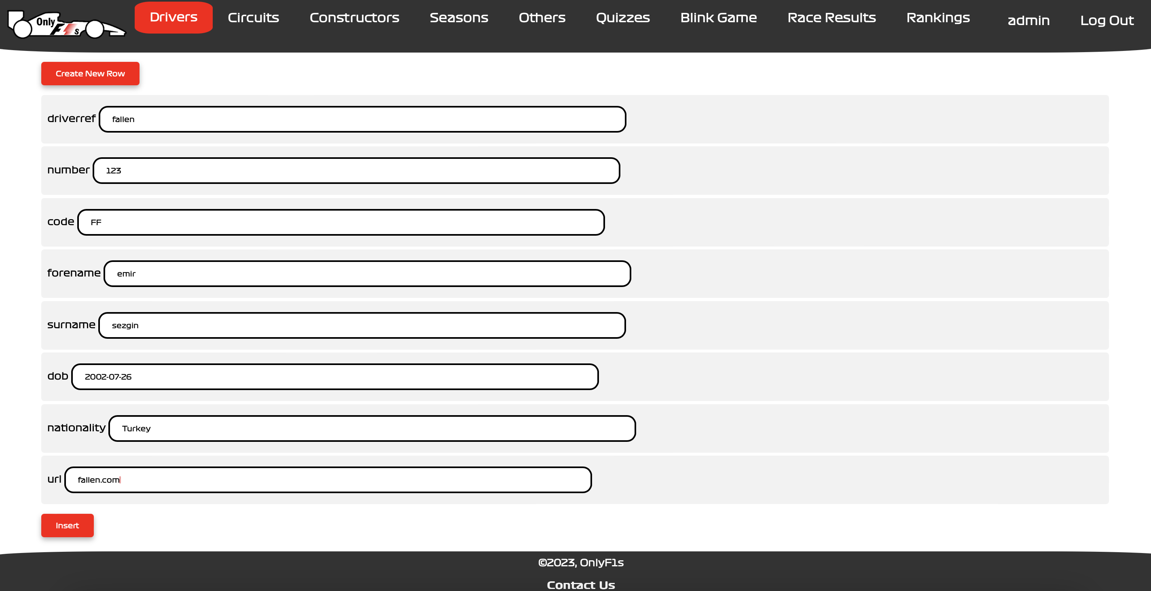
Admin can add a new data to the given page table generically.
CREATE Operation

Slide 8
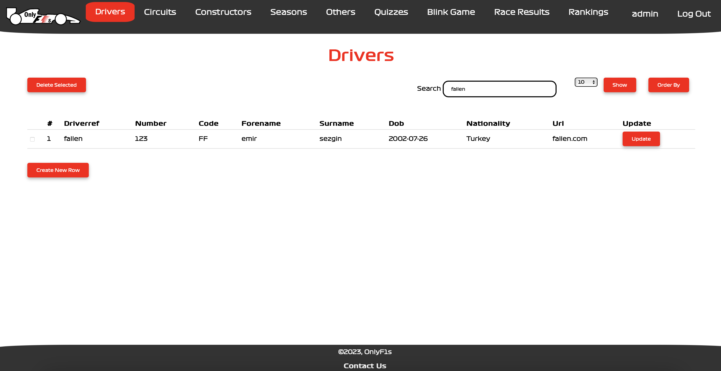
We can search and find the new added data
New added data

Slide 9
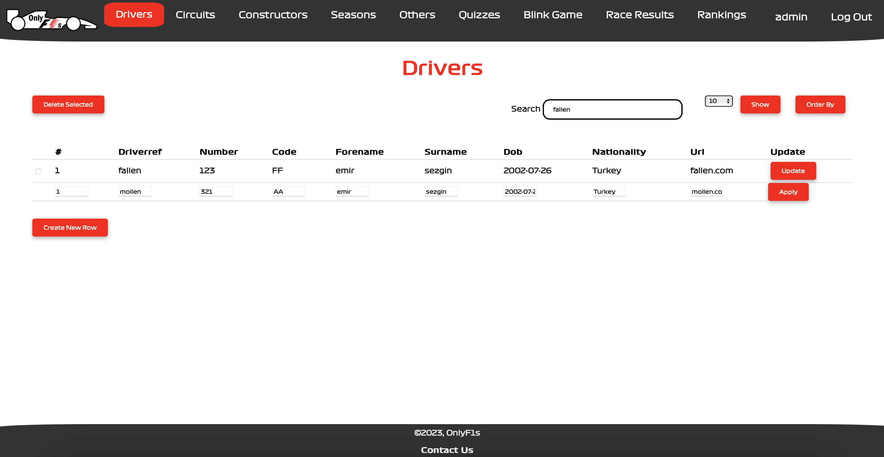
Admin can update the data on the given page generically.
UPDATE Operation

Slide 10

As we see here, we change our data.

Slide 11
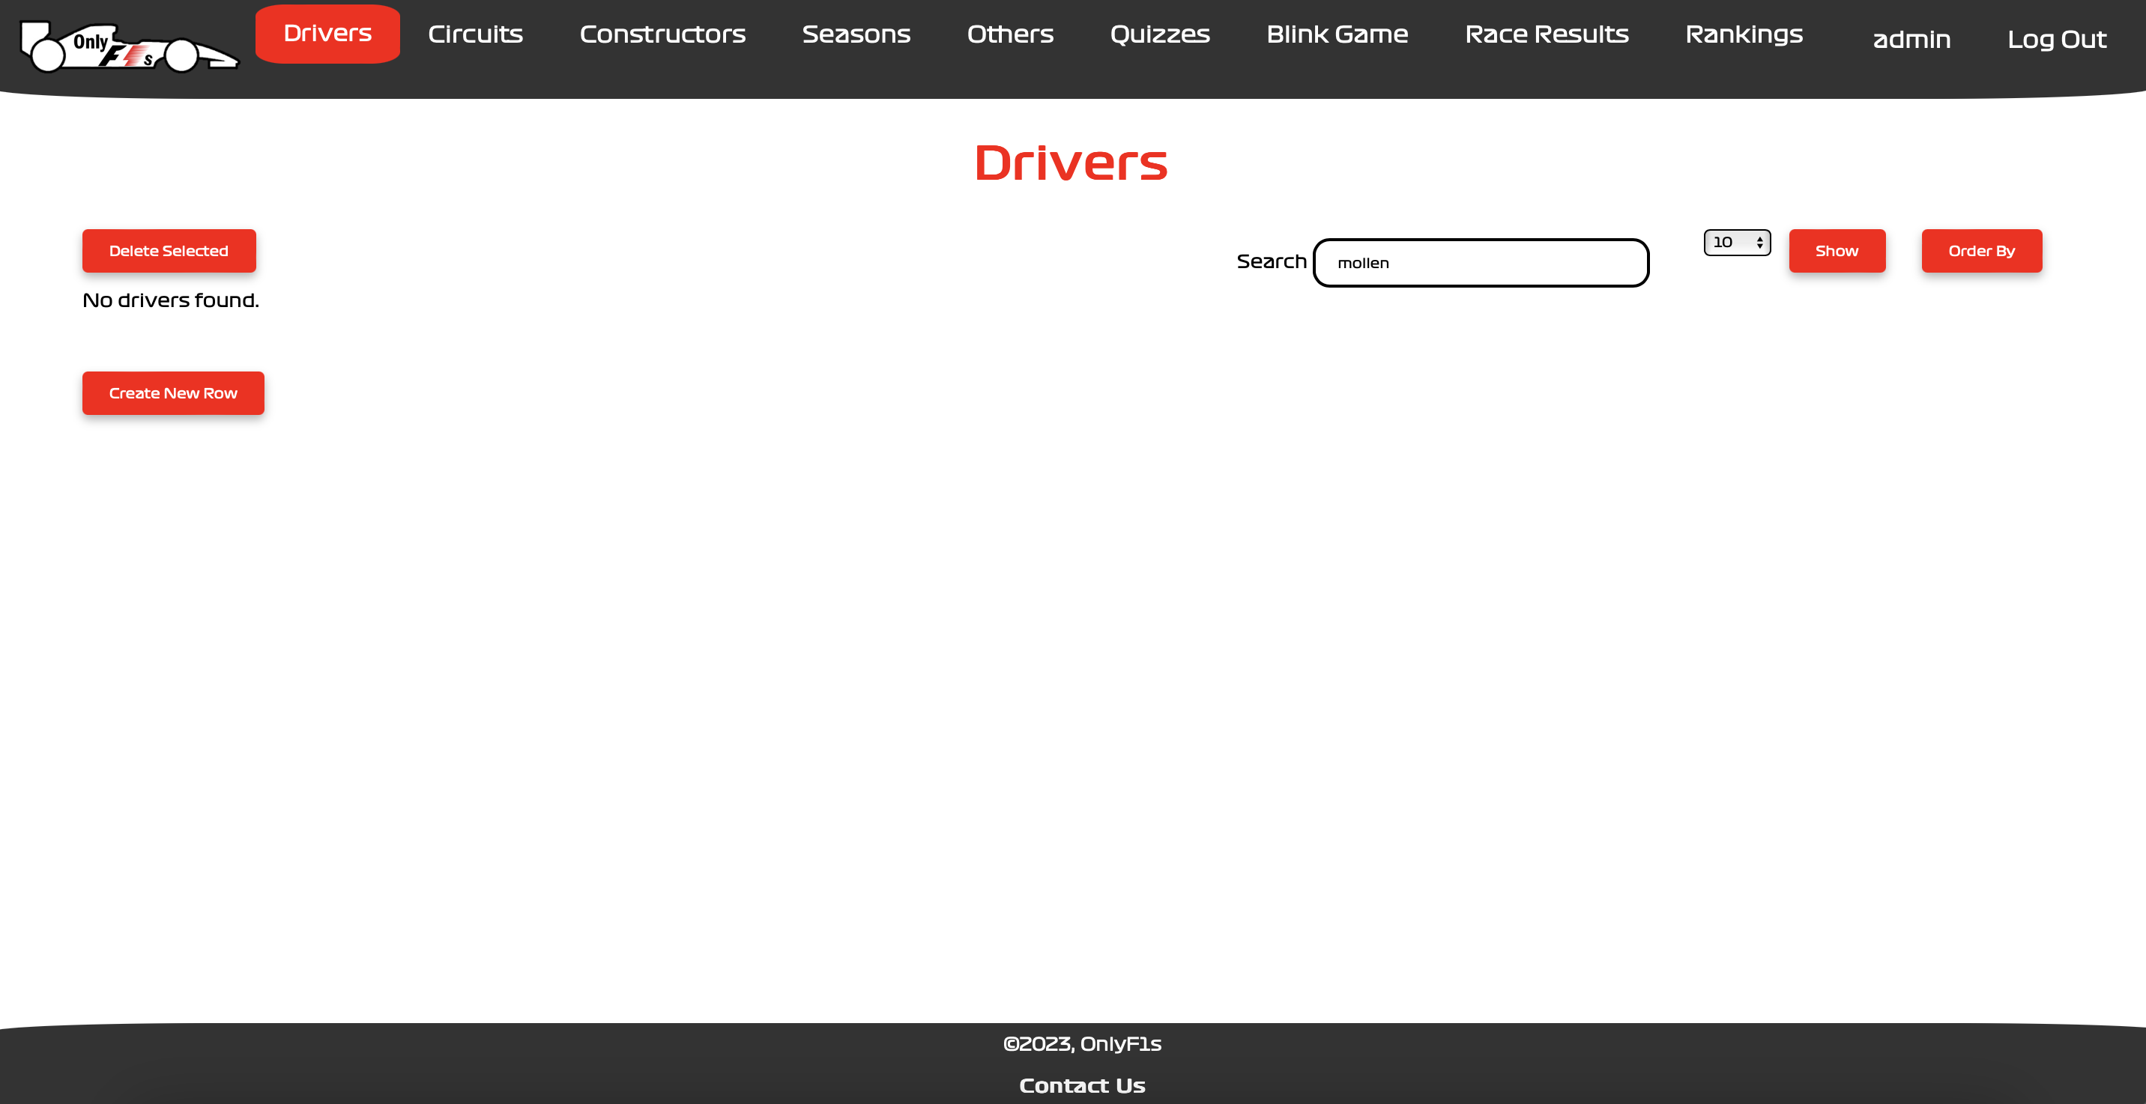
DELETE OPERATION
Admin can delete any row on the given page.
As we can see after deletion we could not find the data that we delete.

Slide 12
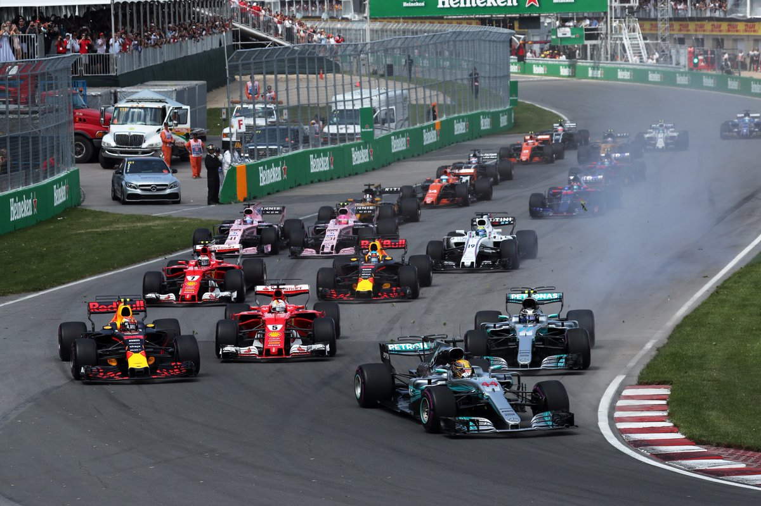
PAGE INFORMATIONS
This Photo by Unknown Author is licensed under CC BY-SA
All pages will be shown on Admin Mode

Slide 13
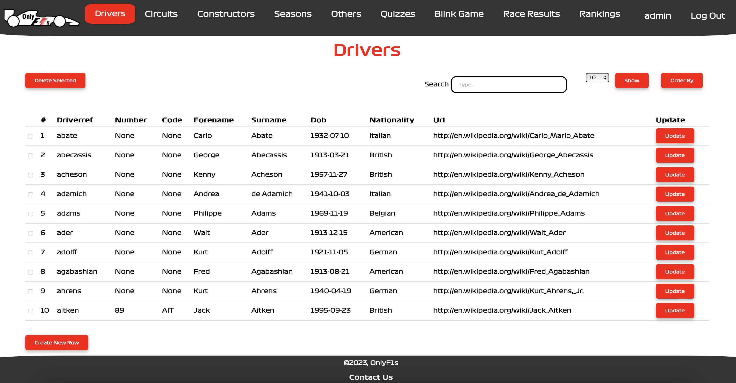
Drivers
We can find any driver by their attribute: Name, Dob…
Also, we can read detailed information about the driver we click on.

Slide 14
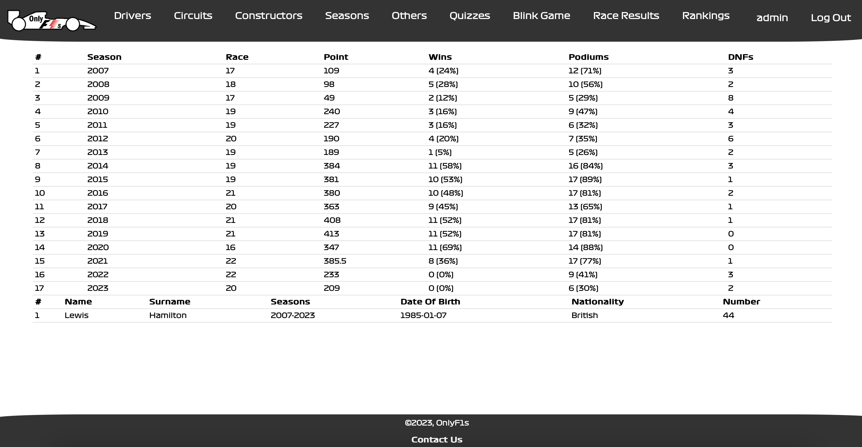
Drivers/DriverDetails
We can see the detailed driver Information.
At the top table Driver Career Info is given.
At the bottom table Driver Personal Info is given.

Slide 15
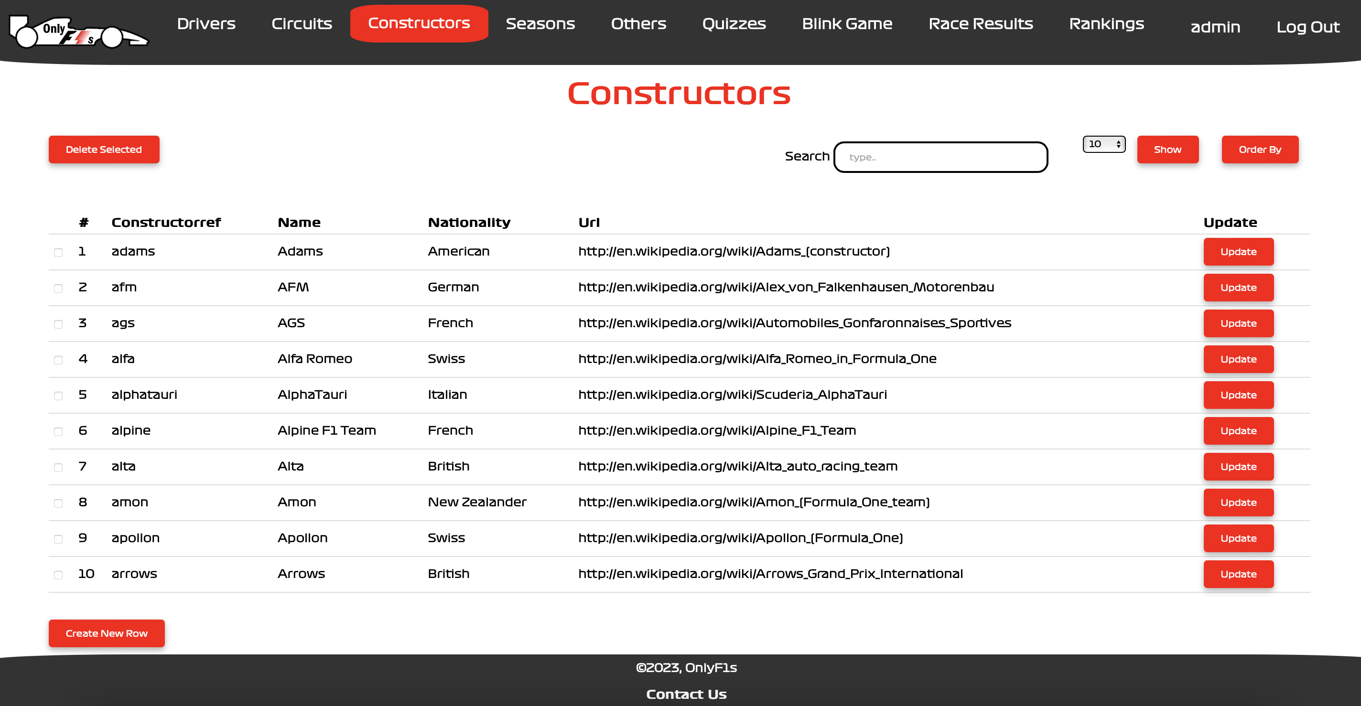
Constructors
We can find any constructor by their attribute: Nationality, Constructorref…
Also, we can read detailed information about the constructor we click on.

Slide 16
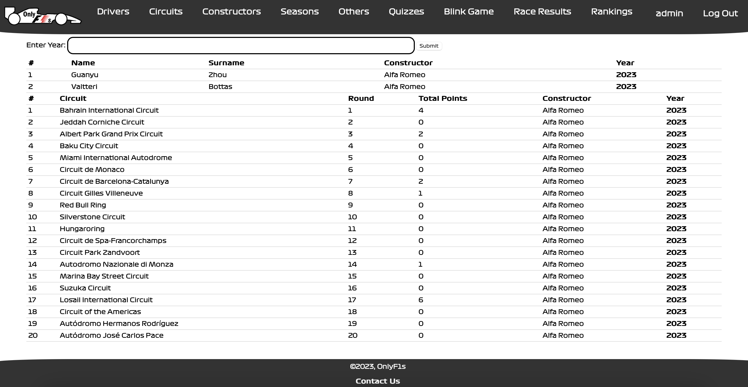
Constructors/ConstructorDetails
We can see the detailed constructor Information.
At the top table Driver Info is given for the given year.
At the bottom table race Info is given for the given year.

Slide 17
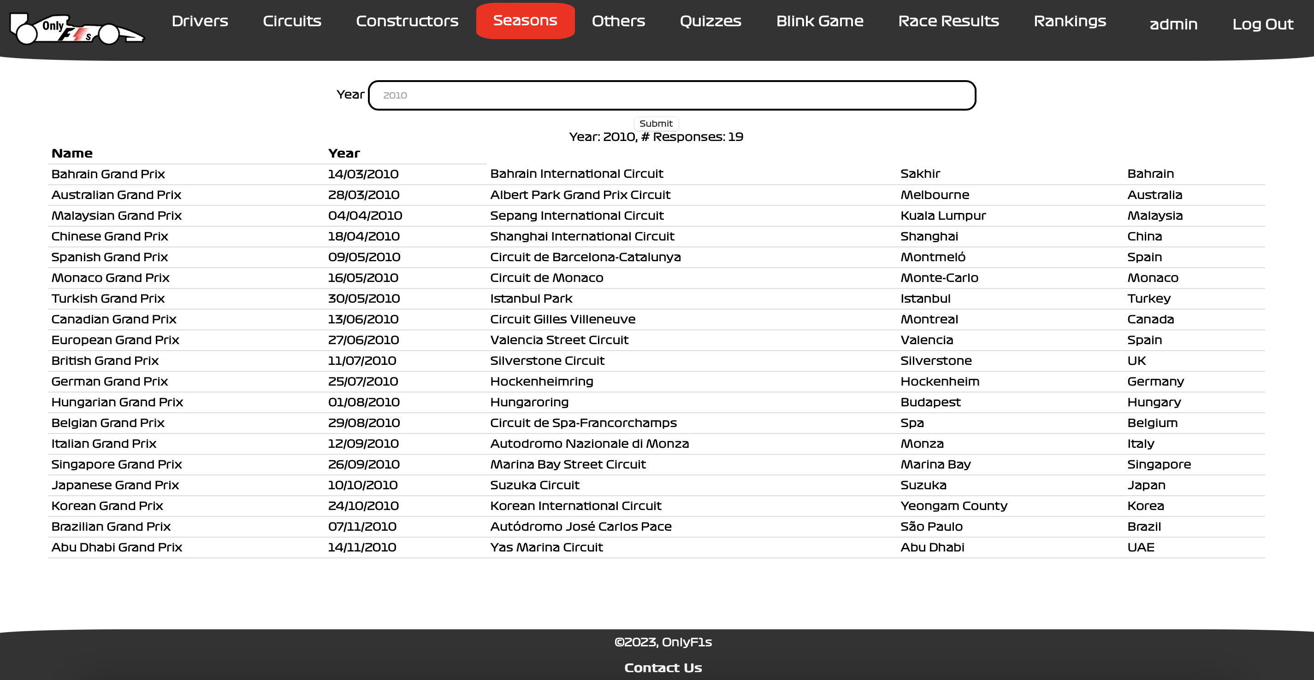
In seasons page, we can find the corresponding races on the searched season year.
Seasons

Slide 18
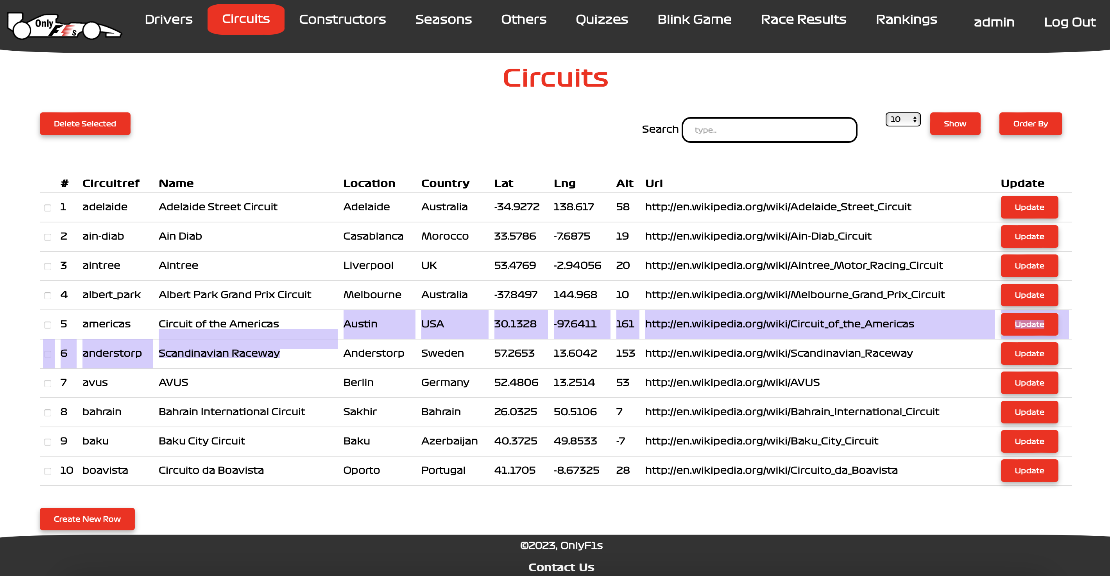
These page will be generically created like others.
Circuits

Slide 19
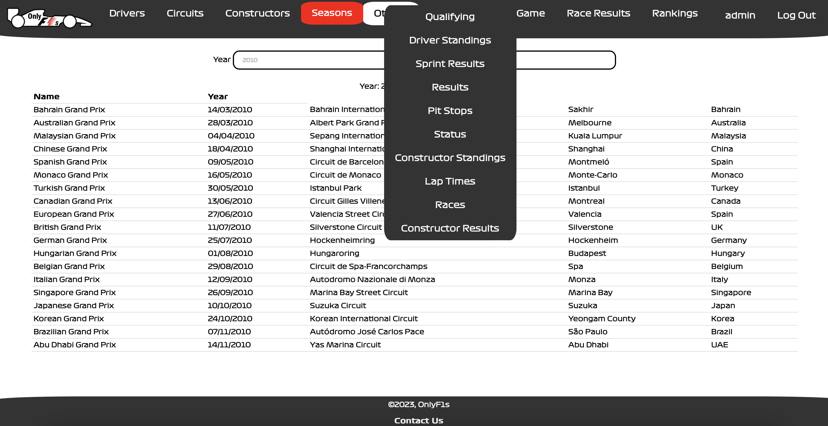
These pages are all generically created.
Others

Slide 20
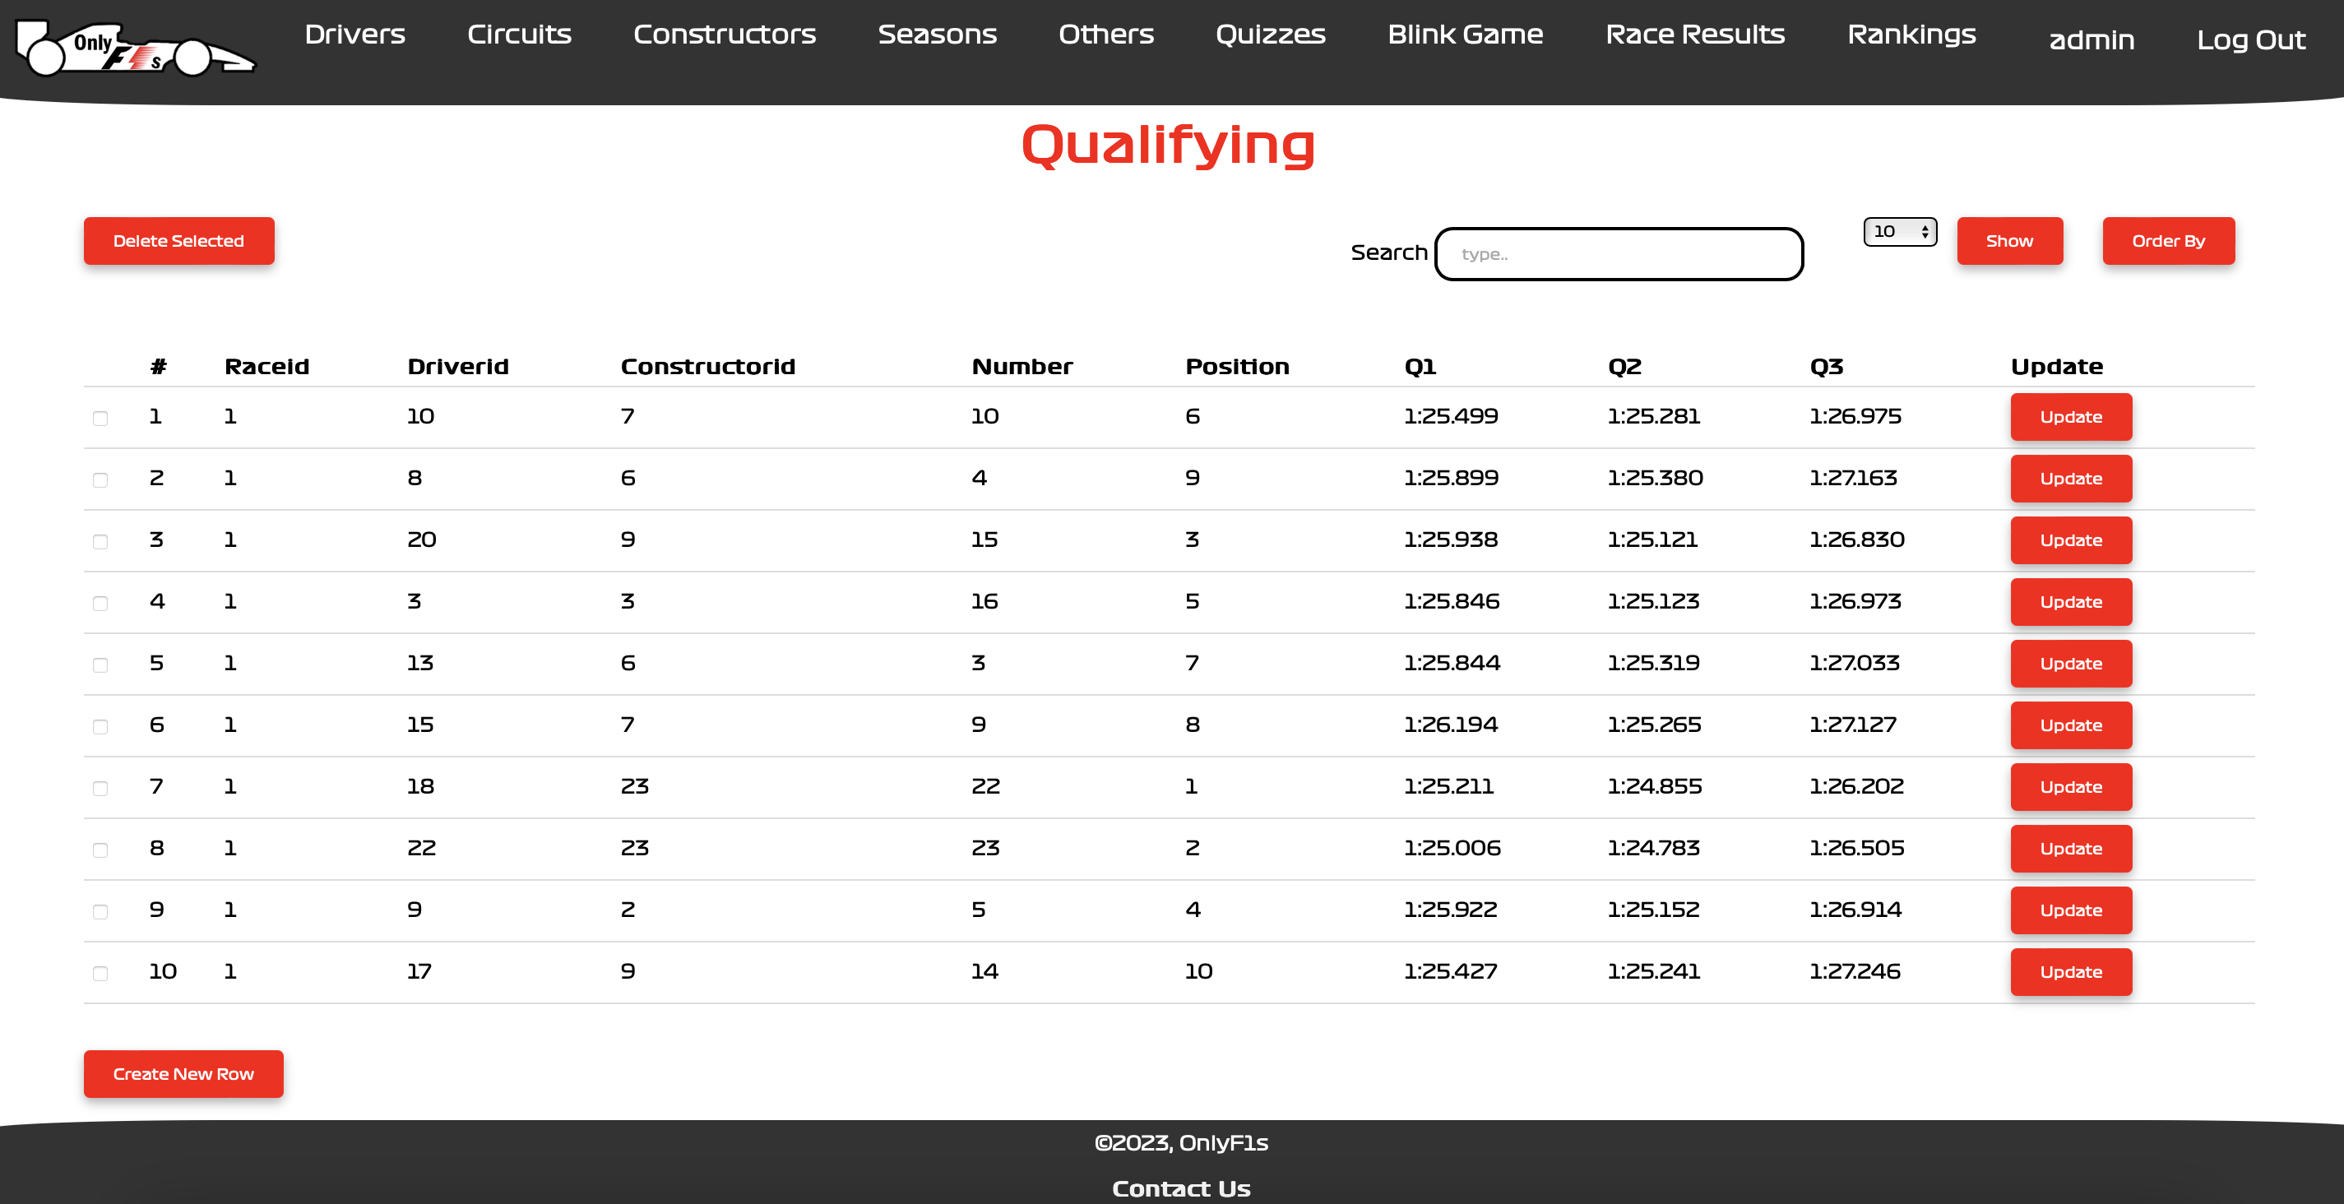
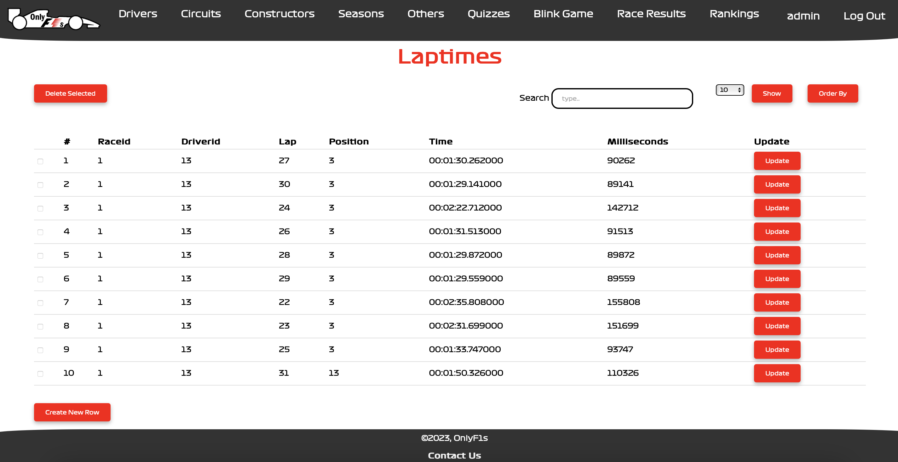
As we see these pages will be generically created.
Also, all the operations will be done generically.

Slide 21
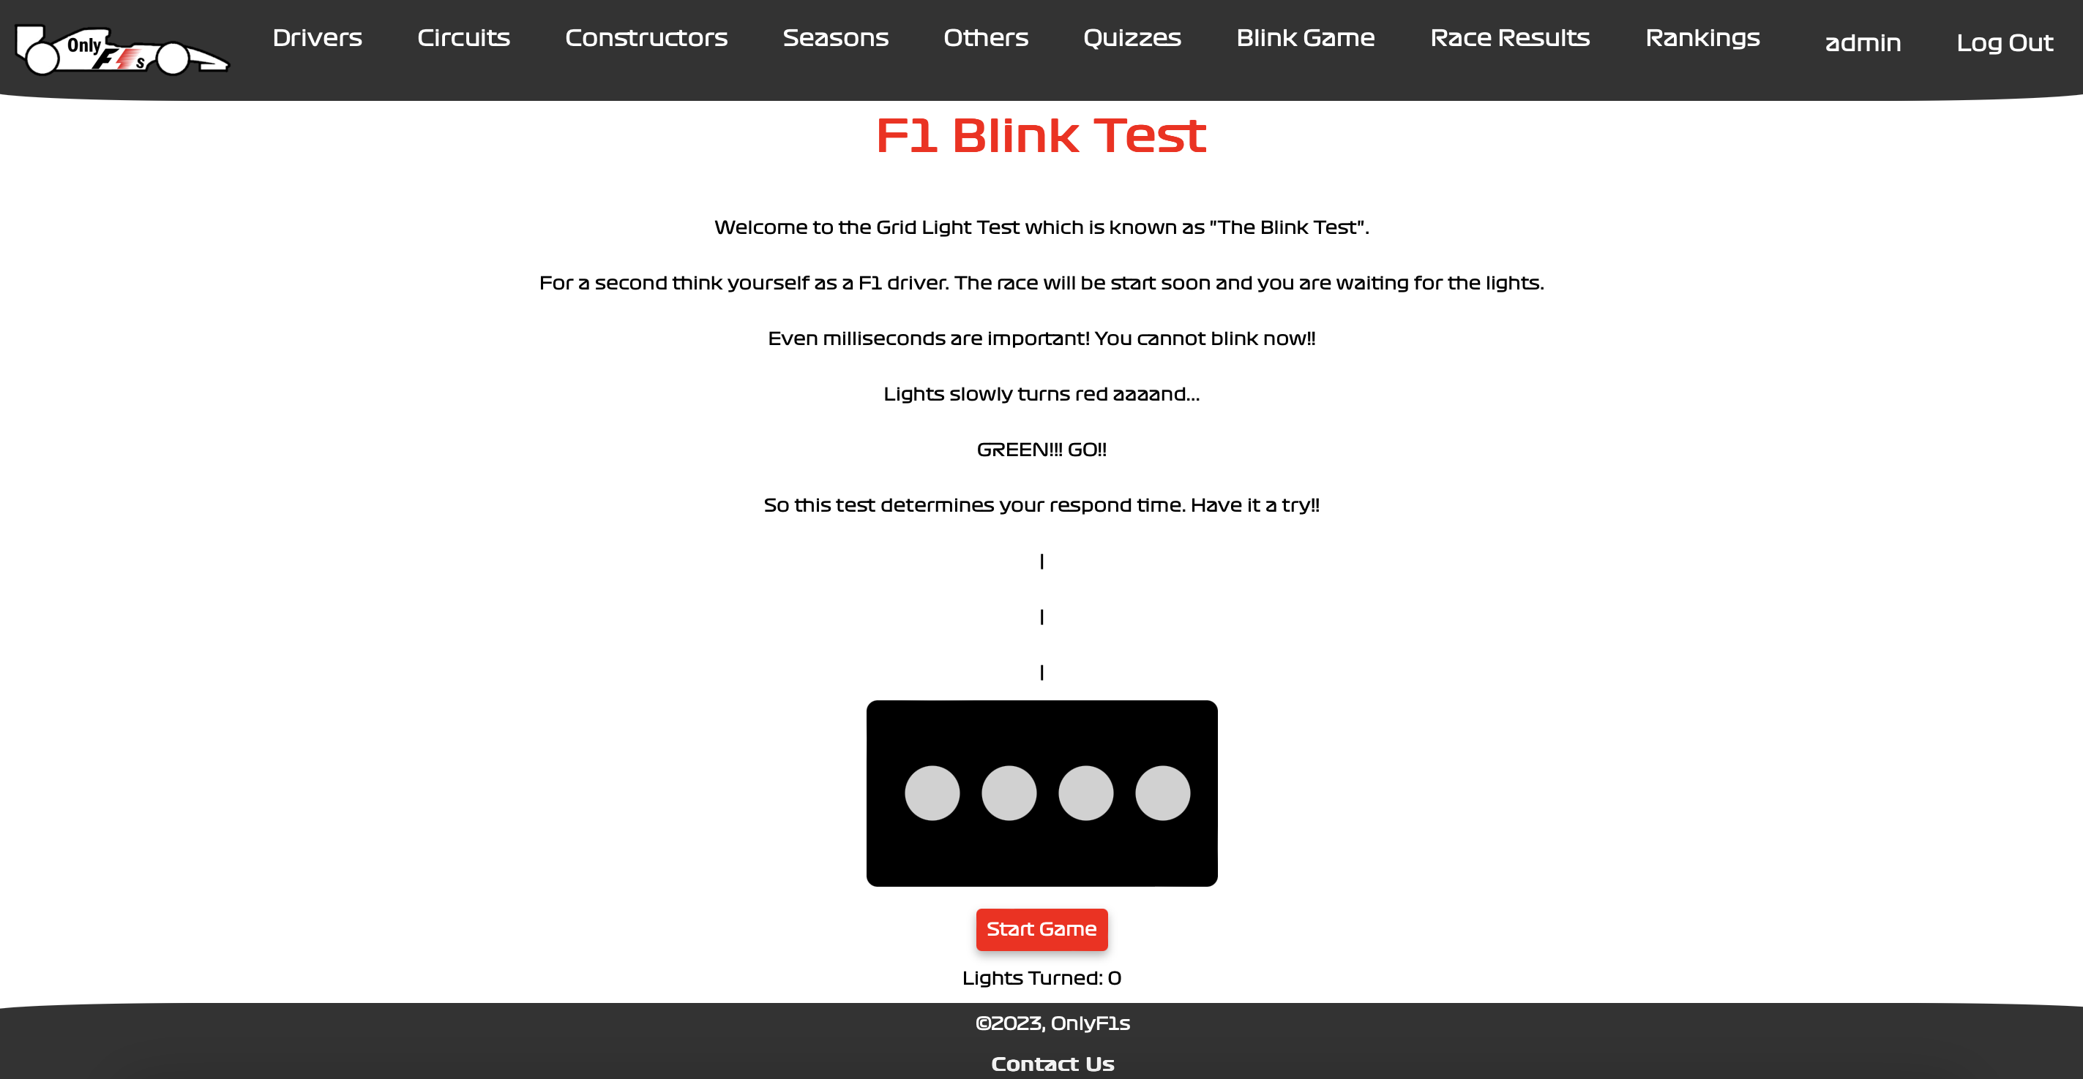
On this page, users can try yourself as an F1 driver!!
Blink Game

Slide 22
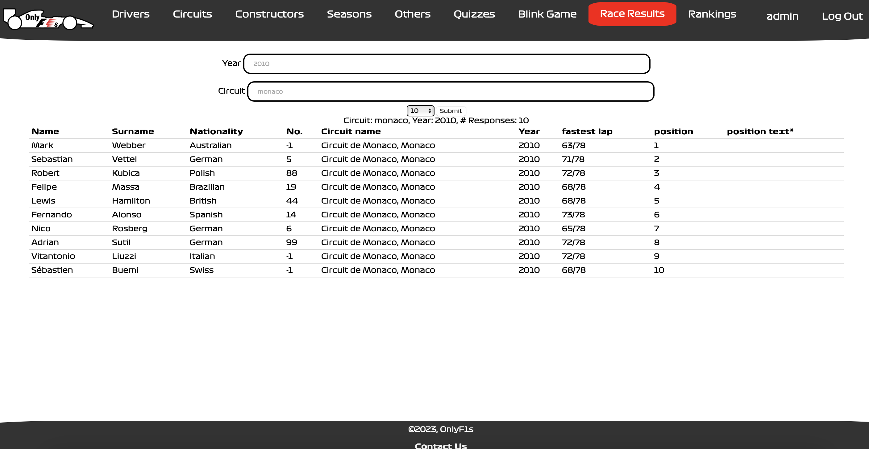
We can find the results of any race in any year on this page.
Race Results

Slide 23
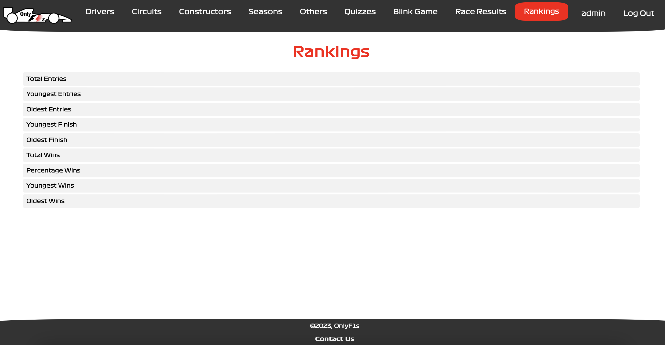
Rankings
We can find different kind of comparison tables.
We can look into them.

Slide 24
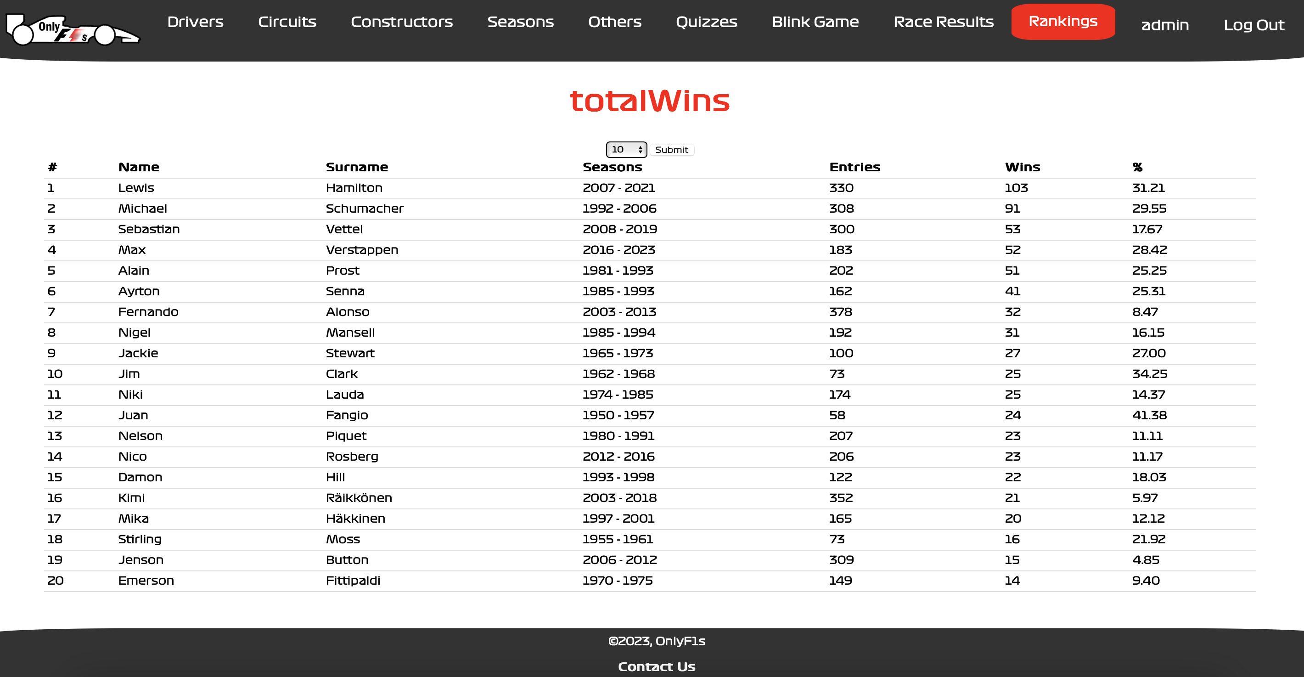
As an example of a rankings pages.
Exp: totalWins

Slide 25
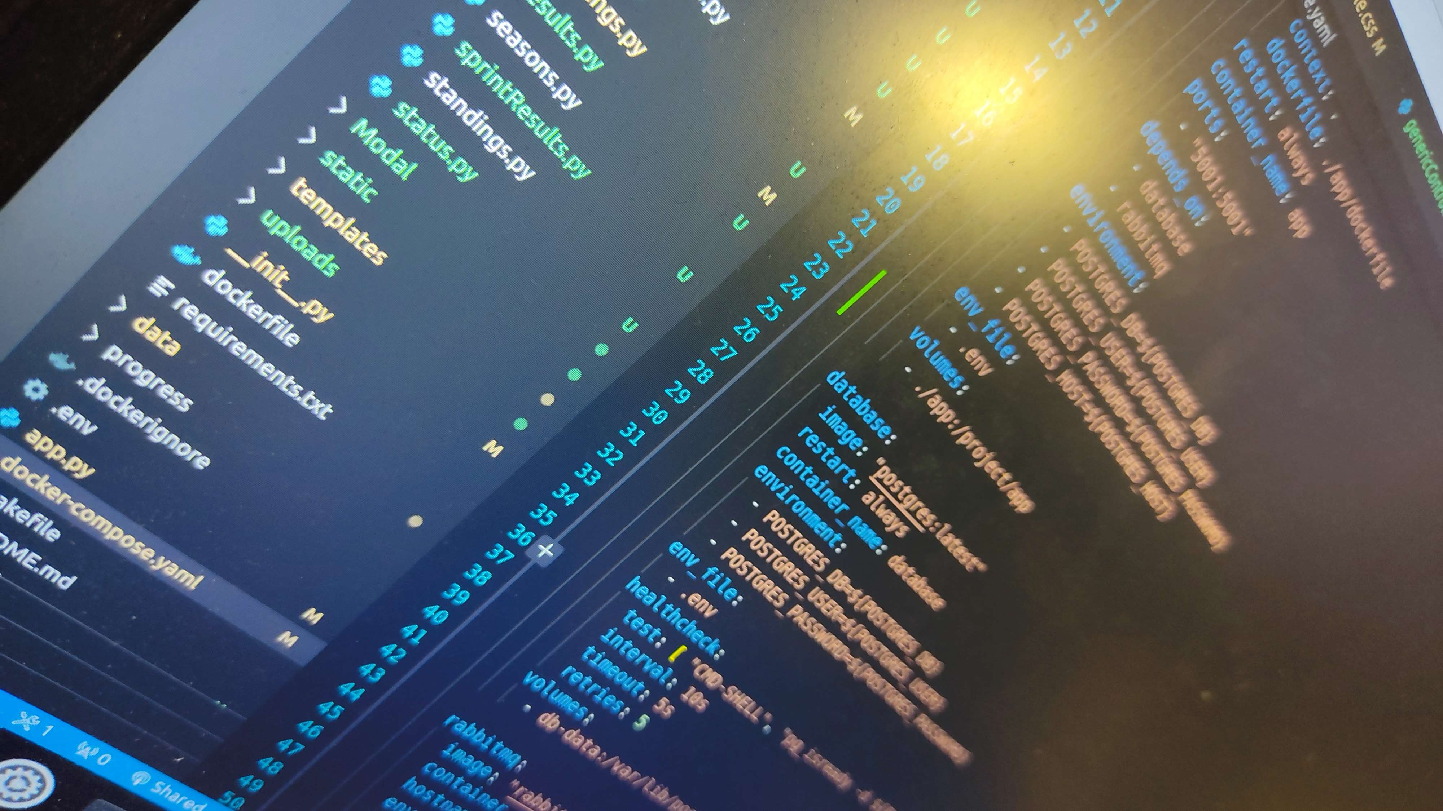
TECHNICAL DETAILS

Slide 26

DOCKERIZING
The project has been dockerized and is supported with Makefiles. The only thing we need to do is run "make up” command, and the project will be up and running. There is no room for the excuse ‘it was working on my local machine’. All features have been implemented within the same structure.
This Photo by Unknown Author is licensed under CC BY-SA-NC

Slide 27

Bulk CUD (Create Update Delete)
For instance you have to delete so many rows from a table. With Bulk CUD, you only write primary keys give a proper name to the csv file, and upload it. Bulk CUD provides an efficient way to perform single-table operations. It starts a transaction, adds the CSV-related generated queries, and commits it processionally.
This Photo by Unknown Author is licensed under CC BY-SA-NC

Slide 28
RabbitMQ
If you generate a mail and send it to the receiver, without RabbitMQ you have to wait for generating the mail and sending it. However, using RabbitMQ while you perform other stuff, the messages will be generated and sent to the receiver asynchronously.
This Photo by Unknown Author is licensed under CC BY-SA-NC

Slide 29
Generic Template
"genericTemplate.html" is a generic HTML page primarily used for rendering multiple pages. It contains buttons for delete, update, search, and insert operations within a table.
This Photo by Unknown Author is licensed under CC BY-SA-NC

Slide 30
Generic Controller
The GenericController manages the creation and direction of generic tables that do not contain their specific pages. It facilitates handling and routing operations for these tables.
This Photo by Unknown Author is licensed under CC BY-SA-NC

Slide 31
MVC Pattern
Using the MVC pattern would mean that you have separated your application into three parts: the Model (which works directly with the database), the View (which is responsible for the user interface), and the Controller (which processes and responds to user inputs). This separation allows for efficient development and maintenance of the project.
This Photo by Unknown Author is licensed under CC BY-SA-NC

Slide 32

SQL Injection Protection
SQL injection is a code injection technique that attackers can use to insert malicious SQL statements into input fields for execution by the underlying SQL database. We used Prepared Statements (with Parameterized Queries).
This Photo by Unknown Author is licensed under CC BY-ND

